Slide 1
Chirau J. Patel
Aerospace Engineering 2017
University of Cincinnati
Choose Ohio First Fellow at Indian Hill High School and St. Xavier High School
“RET is funded by the National Science Foundation, grant #EEC -1404766.”

Slide 2
Unit Overview
Common Core for High School Geometry:
Define trigonometric ratios and solve problems involving right triangles

Slide 3
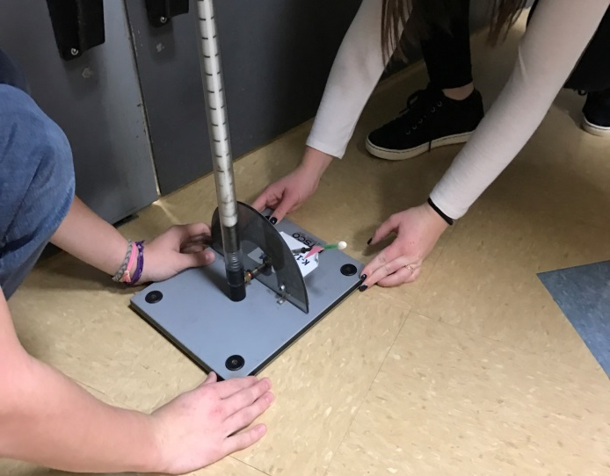
Activity Highlights Starjumpers: Trig Explorers in Space
Guiding Questions:
1) How could trigonometry be applicable in space?
2) What are some variables that could affect the design of straw rockets?
3) How could I make a straw rocket that will land in the target zone?
4) What are important ideas & observations I should keep in mind?
5) What purpose do our group roles play?
6) What drives real-life engineering design?
Objectives:
1) Perform trigonometric calculations to determine where a rocket should land within a target planet zone.
2) Build a straw rocket with preallocated materials through an iterative process.
3) Successfully launch a straw rocket within a target zone distance of 5 to 8 feet.
4) Document design iterations during the activity.
5) Be able to discuss future suggestions based off experience through the activity.

Slide 4
Activities
Students built straw rockets with limited materials and within a limited timeframe to reach a target zone
Students solved trigonometry calculations to get to the next stages of the activity: planet zone launches
Fierce competition also promoted a furthest distance component amongst groups

Slide 5
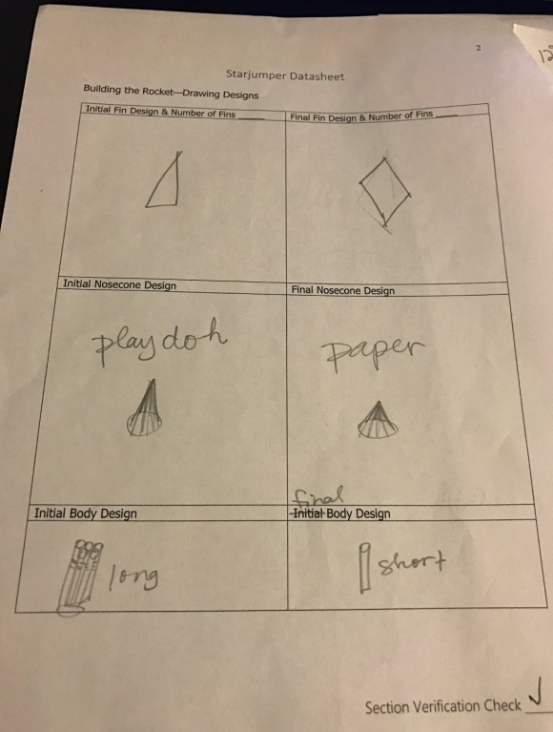
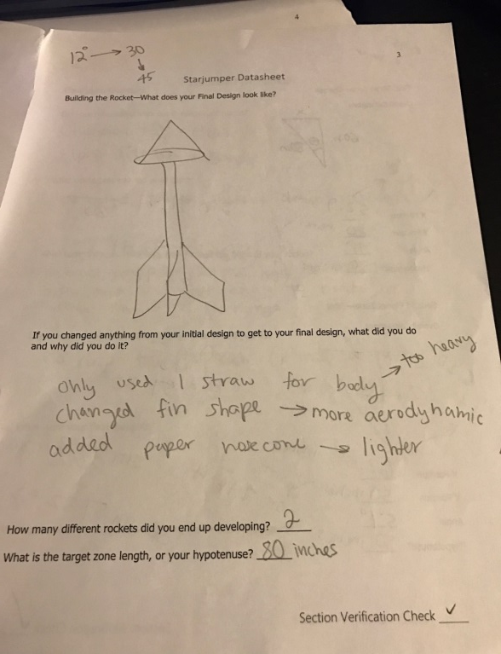
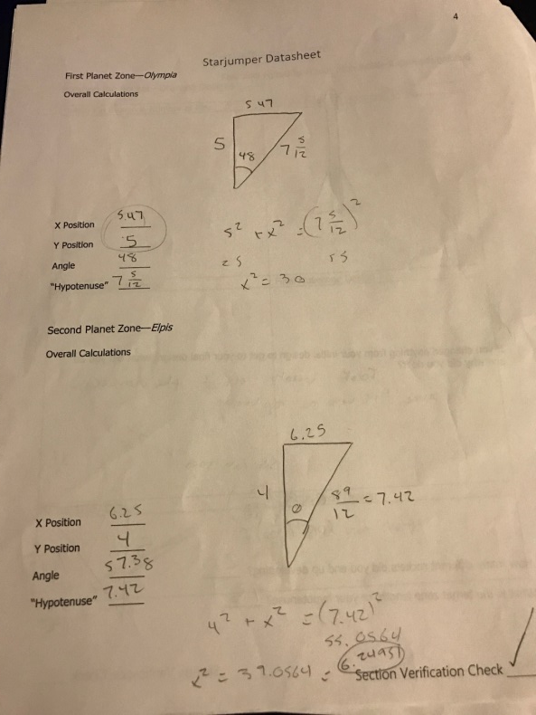
ACS
Application to Real World:
The use of limited time and materials helped simulate the constraints of a real-life engineering project
Through the iterative use of: design, build, test, students got a taste of a real-world engineering project life cycle
Career Awareness:
This activity helped students see real-life careers in aerospace and other forms of general engineering, as well as mathematics and physics pertaining to space
Societal Impact:
Better thinkers
Creative designers
Space and engineering design process aware students

Slide 6
Evidence of Student Learning

Slide 7
Reflections
Future Improvements:
Clear up the trig questions more in-depth
Eliminate the second planet zone launch because students did not launch for it as often
Allow more time for calculations and for the build and test process
Not show a straw rocket model- this allows for the most creative and unseen designs
Successes:
Every single group was excited and engaged
They were able to apply and understand trigonometry
Students launched their rockets with near-perfect accuracy to their planet zone coordinates

